Slide 1
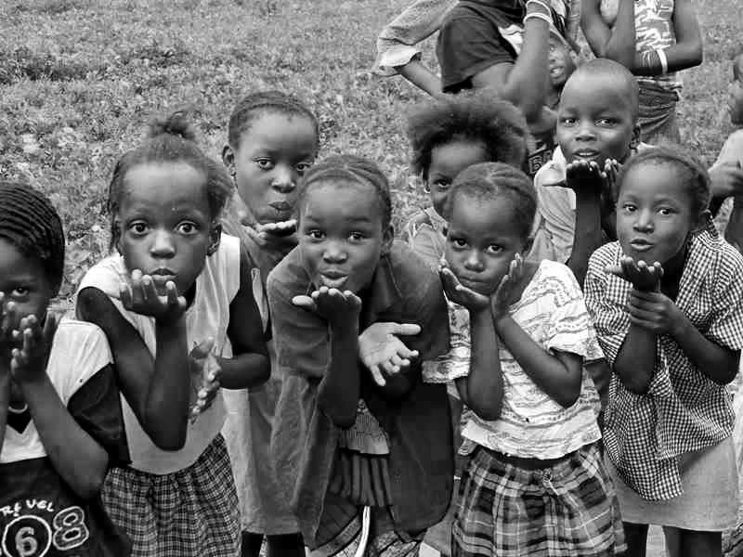
Information Brochure

Slide 2
brief background
Established in December 2002, to support, promote and advance efforts of the Nigerian government and all other stakeholders involved in young people’s developmental activities.
Kids & Teens Resource Centre (K&TRC), is a registered non-profit making, non-religious and non-governmental organization founded upon motivation, love and service towards humanity.
Corporate Affairs Commission : CAC/IT/No.22871
Ministry of Women Affairs: ODMWASD/0010
EU PADOR: NG - 2009-DUB-1310098717
USAID DUNS: 850517583
UN ECOSOC Status SINCE 2017

Slide 3
vision & mission
Internal
The vision of K&TRC is to be a leading organisation that is dependable and trusted to facilitate child and youth development in Nigeria and beyond.
K&TRC’s mission is to enhance the quality of life of children and youth through rights, health care, entrepreneurship, education, agriculture, environmental conservation and ICT for self-reliance.
K&TRC envisions a “secured future” where young people are empowered to contribute to the sustainable development of their communities.
To create an enabling environment for equipping young people with knowledge and skills appropriate for self-actualization and development.
External

Slide 4
who we aim to serve.
Primary Audience:
i. Vulnerable Children especially in rural and excluded communities.
ii. In- School Young People &
iii. Out-of-School Youth.
Secondary Audience
i. Parents and Guardians.
ii. Teachers and Instructors.
iii. Health Care Providers.
iv. Religious & Community Leaders.
v. Duty Bearers & Political Leaders.

Slide 5
where we
are located
We work in rural and marginalized communities in Nigeria.
Kwara
Kaduna
Plateau
FCT (Abuja)
Ekiti
Akure
(Headquarters)

Slide 6
organizational
values
Professionalism
Commitment
Collaboration
Respect
Integrity
Service To Humanity
Downward Accountability

Slide 7
governance structure
K&TRC is a volunteer involving organization with the support of the Voluntary Service Overseas (VSO) Nigeria.
K&TRC has a 5-Person Board of Trustees, 5-Person Management Board of Directors, 18 full-time staff and 10 Support staff.
K&TRC has a pool of volunteers whose talents, time and contributions has been of tremendous support.
K&TRC has a community-based structure too. It comprised the Community Development Committees. We also have crop of volunteers called Community Volunteers (CV) and Caregivers.

Slide 8
thematic
areas
Health
Education
ICT & Resource Centre
Livelihood
Governance
Environment
Community Development
Peace & Conflict Resolution

Slide 9
founding
board members
Prof. Joseph Oluwasanmi - Board Chairperson
Chief Medical Director, Joe-Jane Hospital, Ado-Ekiti, Ekiti State.
08033580628
Prof. Tony Elujoba – Vice Chair
Village Chemist, Pharmacy Department, OAU, Ile-Ife, Osun State
08034025633
Mrs. Caroline M. Fadakinni – Member
Retired Principal, Ondo State Civil Service, Akure, Ondo State
08035031110
Alhaja Olusola Agbaje – Member
Coordinator, Life Care Organization, Ado-Ekiti, Ekiti State.
08035307352
Falana Martin-Mary – Board Secretary/Executive Director
K&TRC, Gaa Akanbi road, Ilorin, Kwara State
08035606915

Slide 11
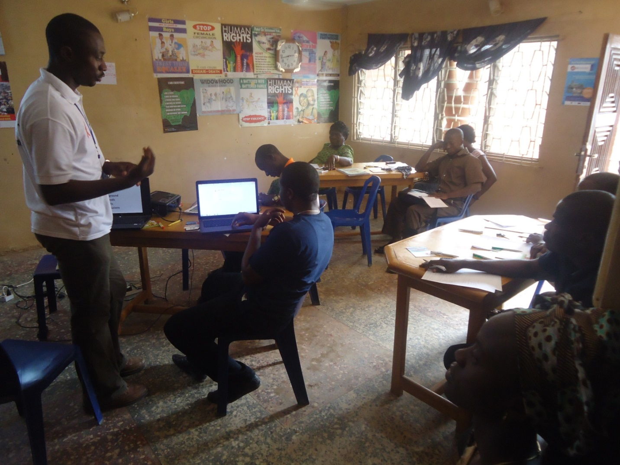
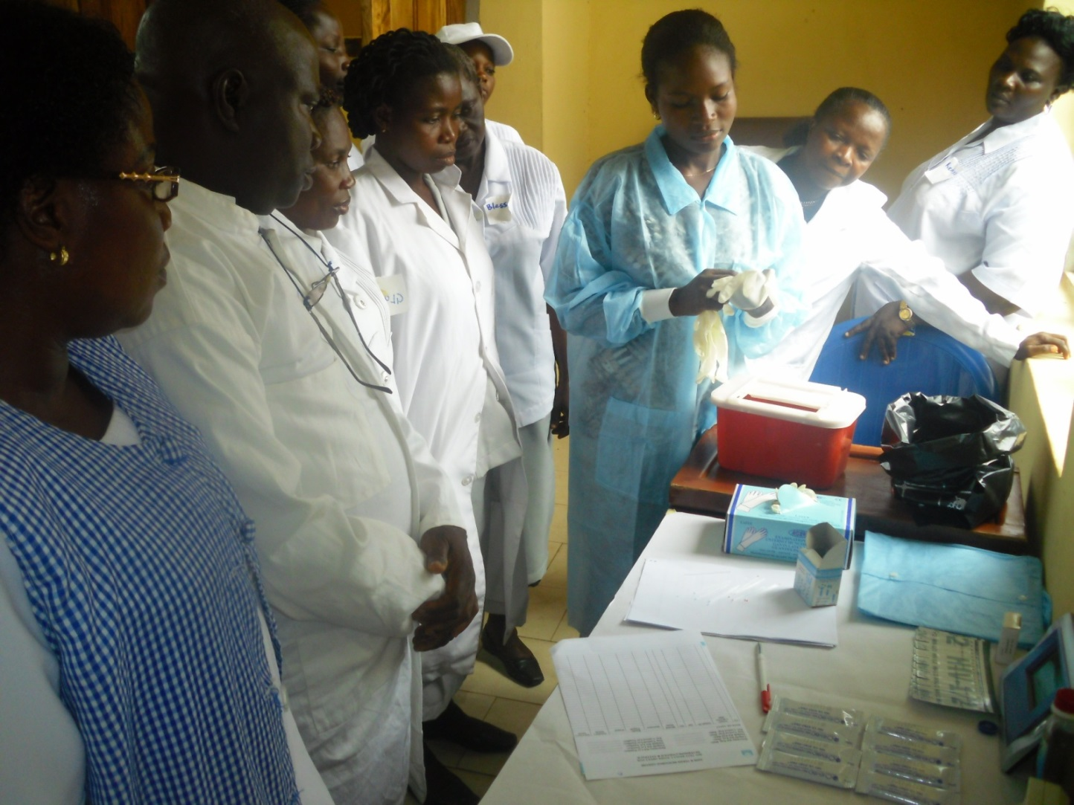
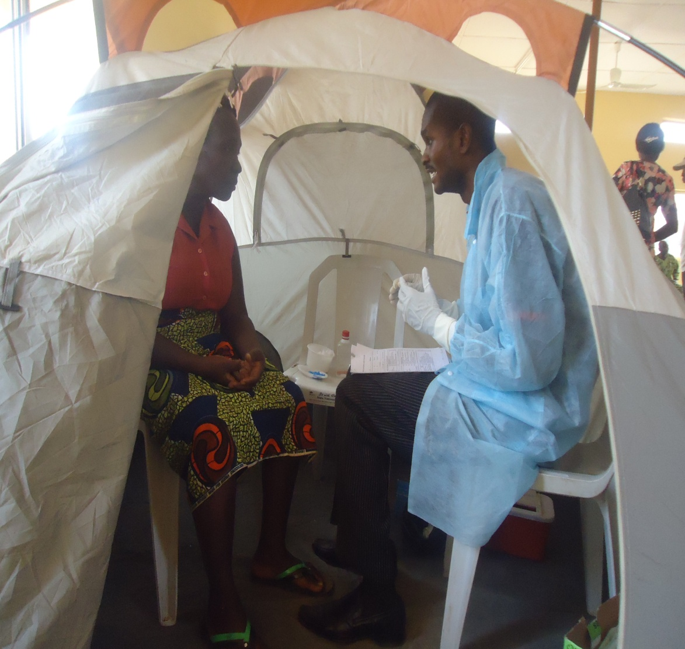
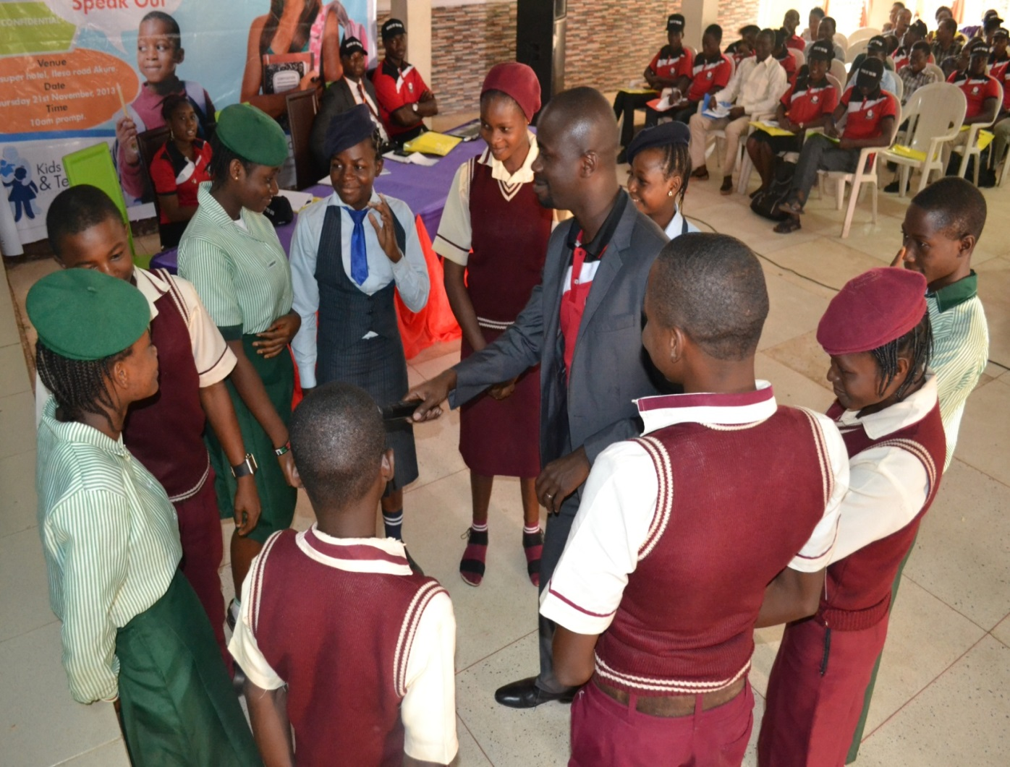
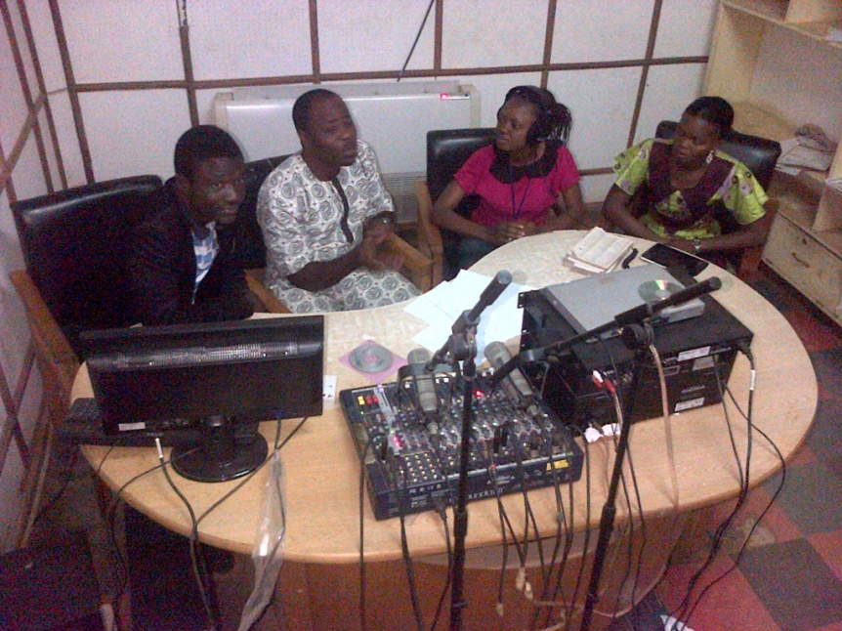
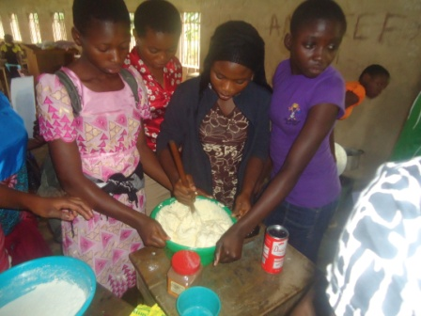
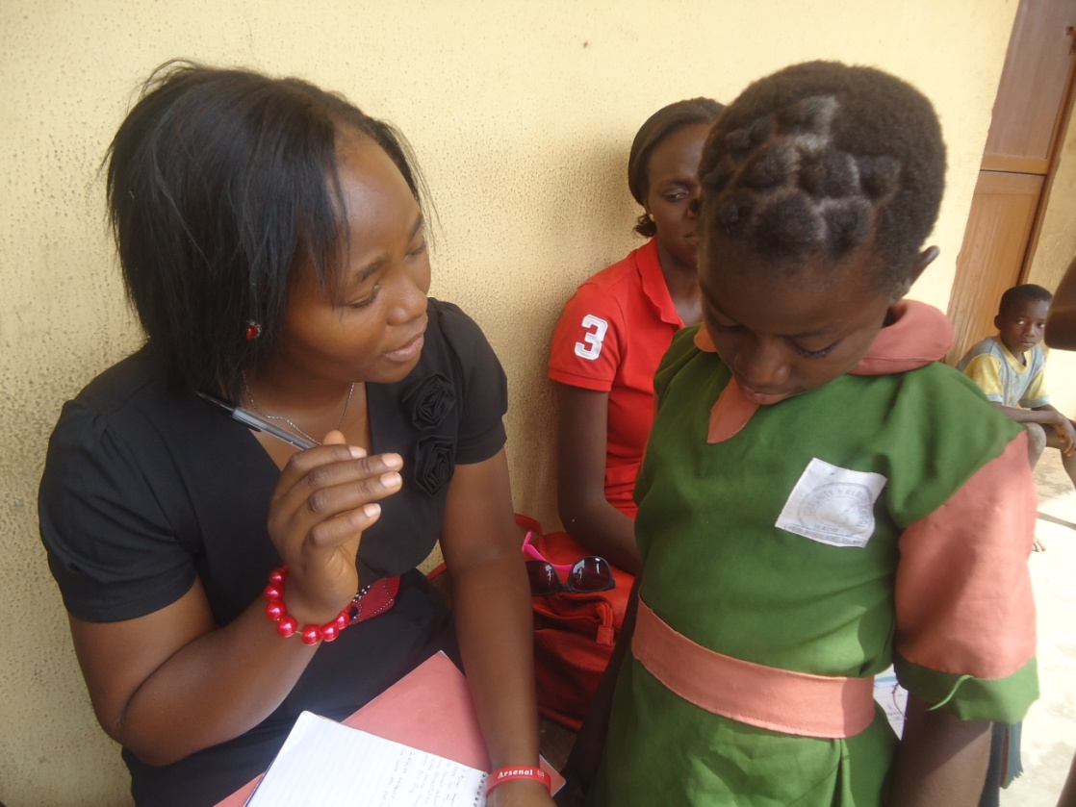
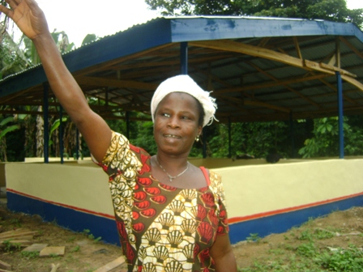
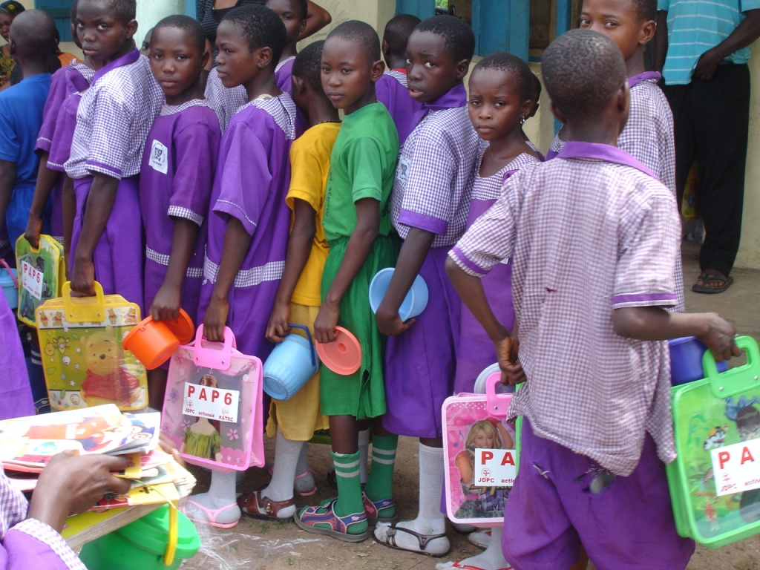
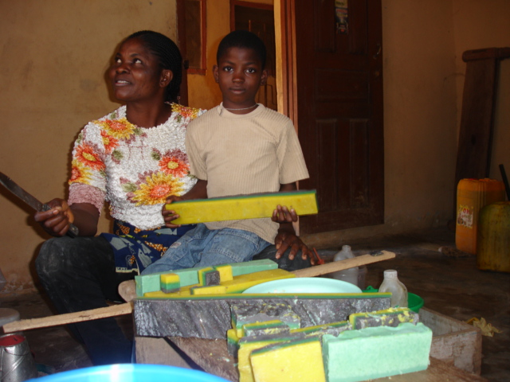
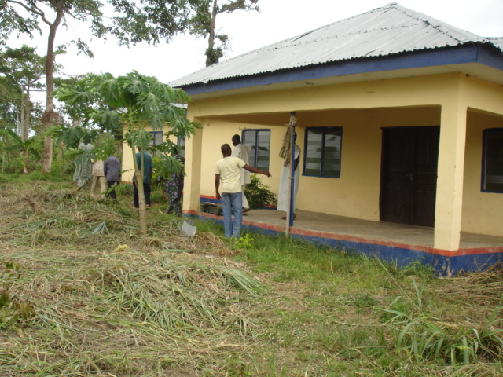
key achievements
in pictures
Information sharing with Sisters’ NGO
K&TRC at a community development project
Health capacity building program
HCT Mobile Tents for testing
Psychosocial Support for Children
Supporting the Construction of Primary Health Centres Ilu Daada
Women economic empowerment project benefactor.
Garri processing plant, Lota-Arogbo
CMC-ICS in action!
Health-Focused Radio Program by Omowumi
Young People Speak-Out Program
Skills Acquisition program for young teenagers.

Slide 12
FORD FOUNDATION SUPPORT
Kids &Teens Resource Centre got the support in the sum of One Hundred and Fifty Thousand USD Dollars ($150,000.00), from the Ford Foundation to implement the organization’s Global Project over a two year period towards partnering with the Ondo state government to ensure that young people access the youth friendly services being provided by the state. (April 2012 – March 2014)

Slide 13
ACHIEVEMENTS
Provided orientation training for 10,530 adolescents on reproductive health issues including facilities and services available towards promoting young people’s access to the facility for effective coverage and delivery of services;
Printed and circulated 500 Social and Behaviour Change Communication materials
Developed and aired jingles for 18 months on popular radio station especially on the youth-run FUTA FM radio (Federal University of Technology Akure radio station);
Used social media networks such as Facebook, Twitter, you-tube and Skype;
Developed and Launched Demand Creation Plan of Action with various stakeholders.
Engaged religious leaders and other stakeholders’ who in partnership and leadership of Kids & Teens Resource Centre will develop strategies aimed at influencing and encouraging youth to access the services and facilities put in place by government,
Built collaborations with existing structures in the Ministries of Health, Education and Youth & Sports towards ensuring synergy and cooperation.

Slide 14
ways you can support us
Our 3G’s proposal:
Give – If you have give us
Get – if you don’t have help us to get.
Generate – Help us with ideas on how we can sustain
Support us in securing a better future for us all.

Slide 16
Thank You All

